Slide 1


NEXT GEN EMPLOYABILITY PROGRAM
CREATING A FUTURE-READY WORKFORCE
Student Name :
Vishnu T
Student ID :
Center Name :
ASAP Alappuzha

Slide 2
CAPSTONE PROJECT SHOWCASE
EzPay - Digital Payment Wallet With MERN Technology
Abstract | Problem Statement | Project Overview | Proposed Solution | Technology Used | Modelling & Results | Conclusion | Q&A

Slide 3
Abstract
1
EzPay is a digital wallet application that allows users to securely add money to their wallet and make payments to other users in the system.
2
To simplify digital transactions and provide a fast, secure, and user-friendly platform for managing payments.
3
Users can load money into their wallet, make payments, and view transaction history.
4
Built using the MERN (MongoDB, Express.js, React.js, Node.js) stack for an efficient and scalable digital payment solution.

Slide 4


Problem Statement
In today's fast-paced world, users face challenges in making quick and secure transactions, particularly in scenarios where traditional cash or card payments are inconvenient. Existing solutions may involve complex processes, lack wallet management features, or fail to deliver a seamless payment experience. There is a need for a simplified and secure digital wallet system that enables users to easily add, manage, and spend money payments.

Slide 5

Project Overview
The EzPay application is a digital wallet platform designed to provide users with a seamless and efficient payment solution. The primary objective is to allow users to securely add money to their wallet, manage their balance, and make payments effortlessly by scanning QR codes. Targeting individuals, small vendors, and businesses, the platform simplifies day-to-day transactions by eliminating the need for cash or physical cards. Key features include the ability to load funds securely, process payments instantly through QR code scanning, and track all transactions through a detailed and user-friendly transaction history.

Slide 6
Proposed Solution
The Easy Pay application provides a robust and user-friendly digital wallet platform where users can:
Add Money: Easily load funds into their wallet through integrated payment methods (e.g., card, net banking).
QR Code Payments (will be implemented later ) : Make seamless transactions by scanning QR codes, eliminating the need for cash or physical cards.
Wallet Management: Monitor wallet balance and transaction history in real-time to keep track of spending.
Security: Incorporates secure user authentication and encrypted transactions to ensure data safety and privacy.

Slide 7
Technology used
Backend: Node.js with Express.js Frontend: React.js , Tailwind CSS Database: MongoDB

Slide 8
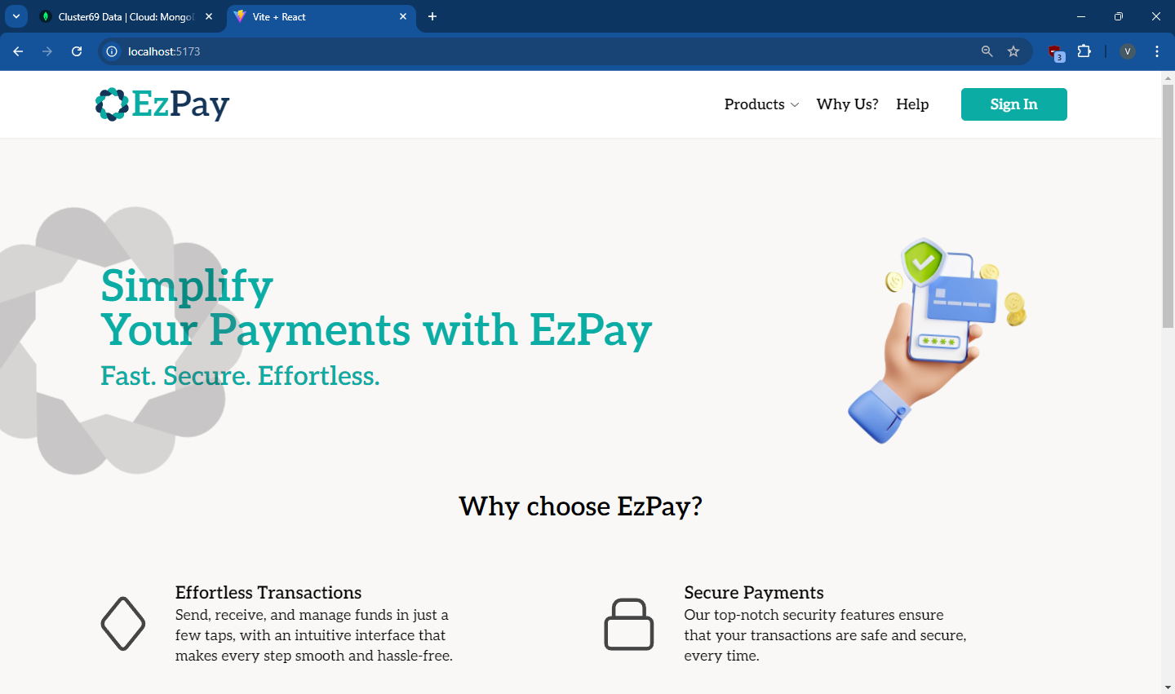
Sample screenshots
Fig1 : landing page

Slide 9
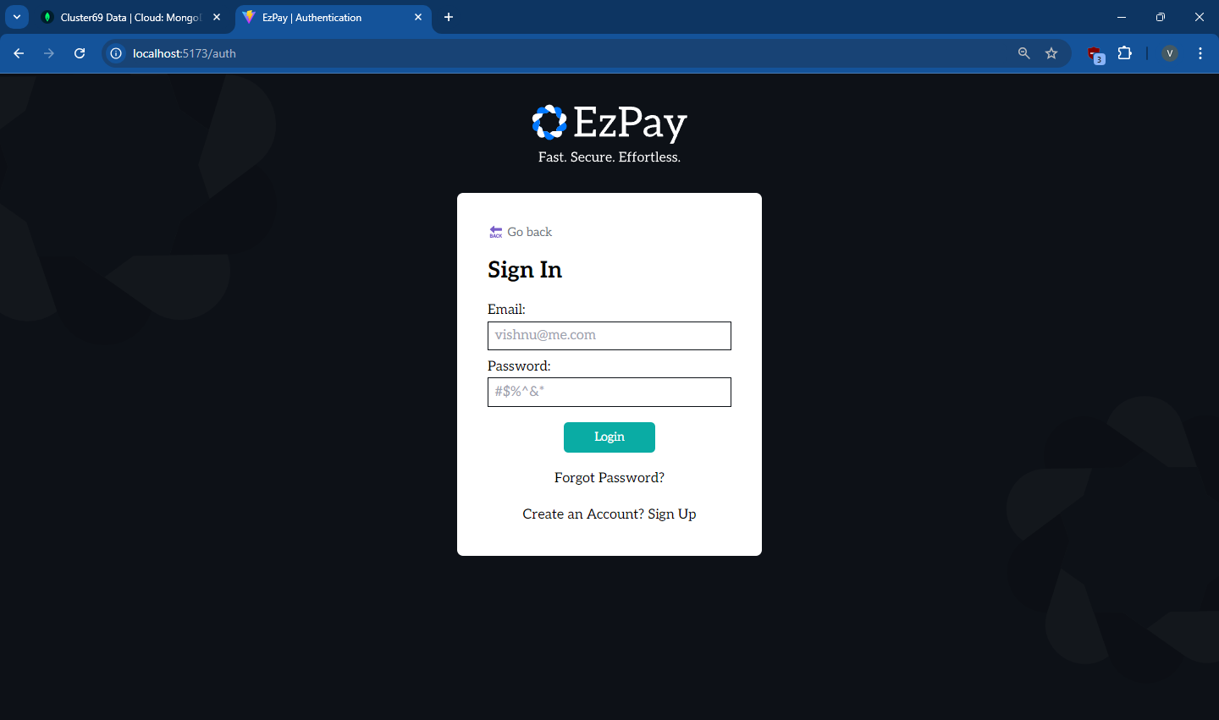
Fig2 : Authentication page

Slide 10
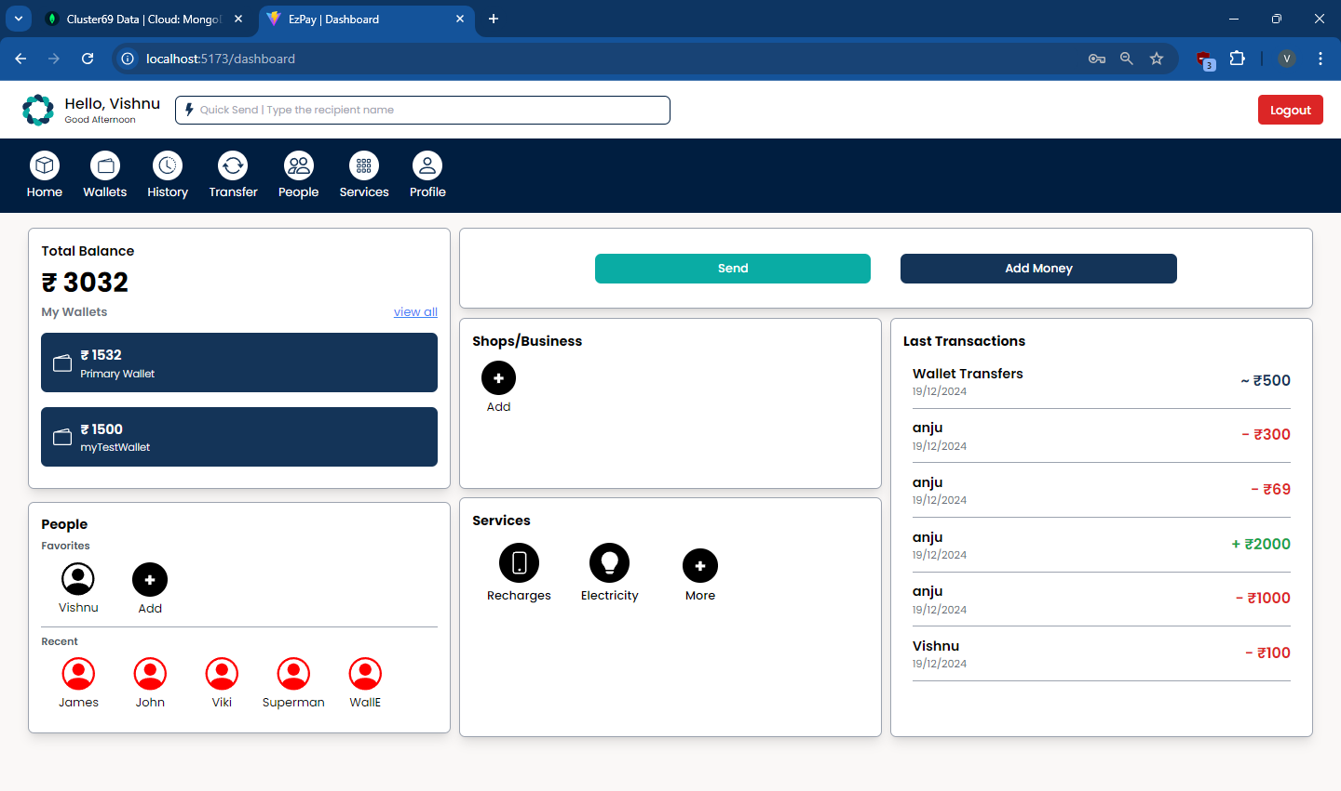
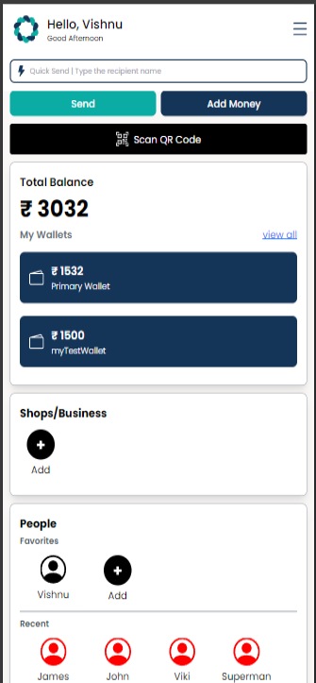
Fig3.1 : PC - Dashboard
Fig3.2 : Mobile - Dashboard

Slide 11
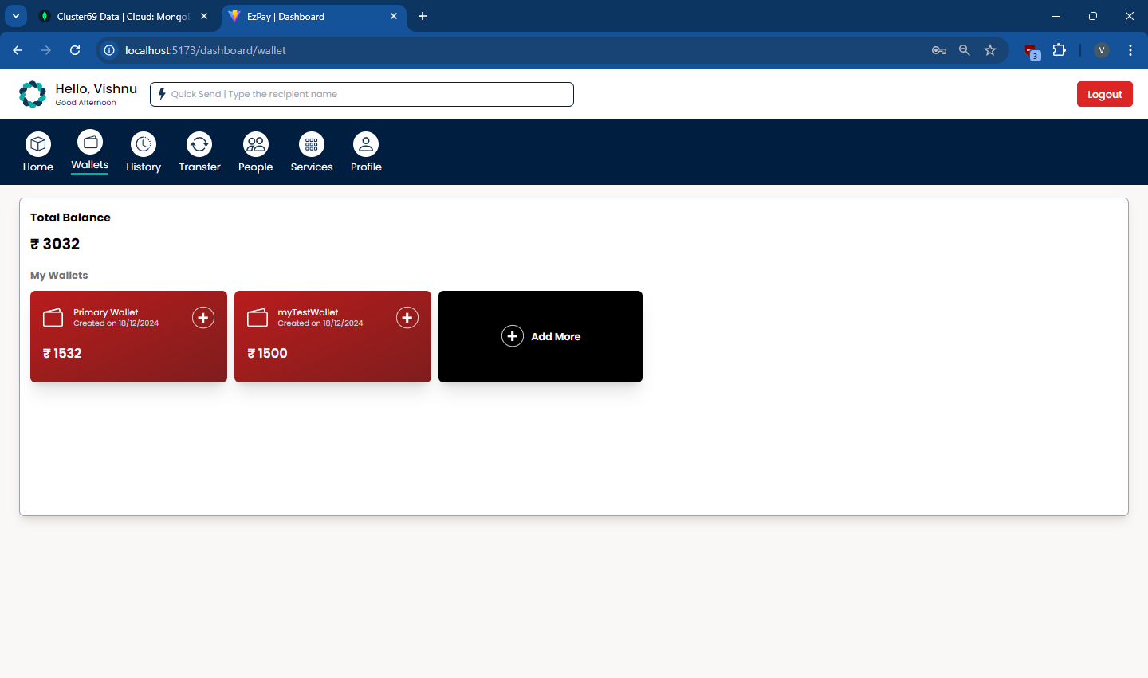
Fig4 : Wallets overview

Slide 12
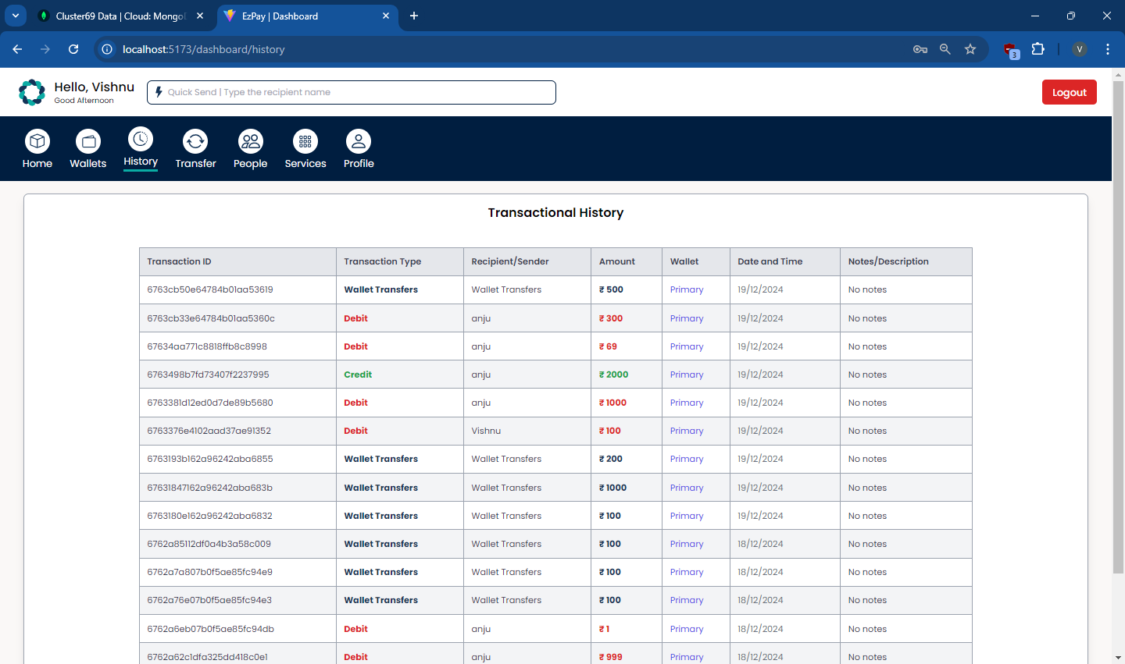
Fig5 : Transaction History

Slide 13
Conclusion
The EzPay application provides a fast, secure, and user-friendly solution for digital transactions. By offering wallet management and seamless money transfers, it simplifies everyday transactions for users. The application improves payment efficiency, reduces dependency on cash, and enhances financial management.

Slide 14


Notes:
Thank You !!

